Slide 1
Lab 7: using "not"
Below is the input.
The input contains a title followed by one or more lines.
Discard newlines.
Name the start rule: document
See the next slide for what the parse tree should look like.
input.txt
Gettysburg Address
Four score and seven years ago our fathers brought forth on this continent,
a new nation, conceived in Liberty, and dedicated to the proposition that
all men are created equal.

Slide 2
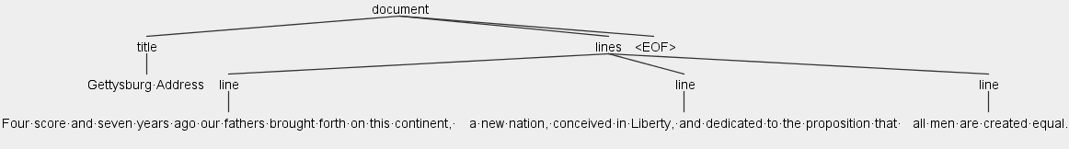
Output (parse tree)

